Slide 1

Resume SCREENING AND FILTRATION SYSTEM
Logan Roach
Diganta rashed

Slide 2
Introduction and Overview
https://www.kaggle.com/datasets/snehaanbhawal/resume-dataset
https://www.kaggle.com/datasets/jillanisofttech/updated-resume-dataset
Collection of Resume Examples
Categorical Screening
Divide by industry, job title, and quantify number of keywords
Train model to recognize key terms in each industry

Slide 3

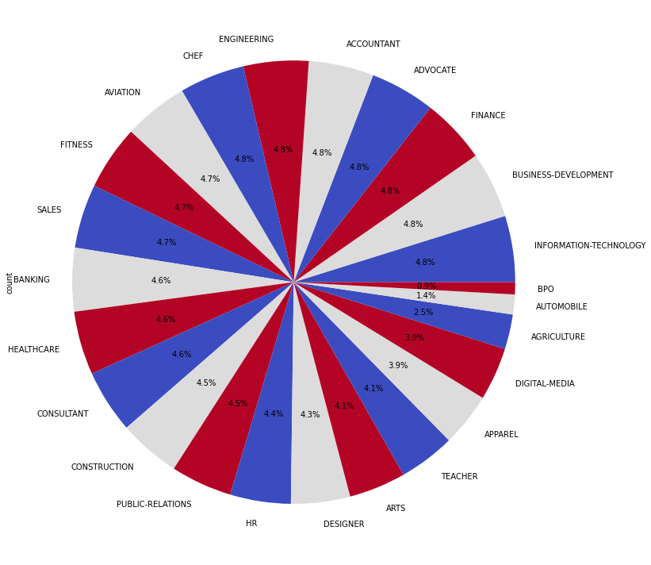
About The Data
Labeled Data
First column (Resume_str) contains the resumes in the form of a text string
Second column (Category) contains the category
2,484 resumes included in the data set
24 resume categories
Additional 962 resumes with 25 categories labeled similarly to the larger dataset
Notes:
Labeled Data
First column (Resume_str) contains the resumes in the form of a text string
Second column (Category) contains the category
2,484 resumes included in the data set
24 resume categories
Additional 962 resumes with 25 categories labeled similarly to the larger dataset

Slide 4
Key features
Latent Dirchlet Allocation model
Topic based categorization to divide resumes based on category
Organization based on keywords for each topic
K-nearest neighbors
Classification system for proximal terms to group based on association
Clustering-based classification can help us understand how frequent terms used in our resume sample are repeated
Notes:
We want to use Latent Dirichlet Allocation for topic modeling to analyze resumes and extract topics that represent the skills or qualifications desired for the job. This additional model would help to efficiently identify candidates whose skills and qualifications match the requirements of the job.

Slide 5
Data cleaning and preprocessing
Stop-words removed using the Natural Language Toolkit "english" stop-words
All data was set to lowercase
Used TF_IDF vectorization to instantiate the resume text data

Slide 6
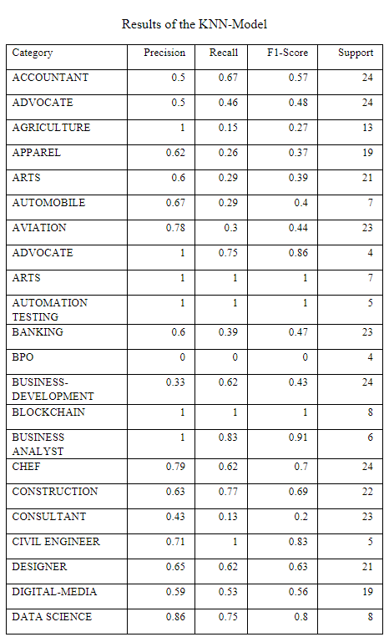
The KNN Model
Various topics successfully iterated and trained in terms of frequently appearing words
Indication of high frequency appearance
Effective at training the model based on its own set
Concern of homogeneity in key terms
Most instances of perfect recall = small samples, larger sets have lesser and lesser accuracy

Slide 7
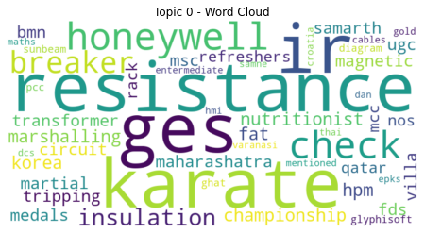
The LDA model
Generated 10, 100, and 500 topics across different iterations of the model
Topics seemed to be organized by different industries with small overlaps
The topics were then used as features in SVC and Random Forest Models

Slide 8

Findings - Incorporating LDA into The Classifier Models
The results of incorporating the LDA topics as features in the Support Vector Classifier and Random Forest Models were very poor
The best performing models used the LDA model with the most topics (500 topics)
SVC: 27.97% accuracy
Random Forest: 53.76%

Slide 9

Findings - of Not Incorporating LDA into The Models
The Support Vector Classifier and Random Forest Models performed quite well when not including the LDA topics as features.
Using the vectorized resume data, the top performing model was the Random Forest Model by the slimmest margin.
SVC: 73.91% accuracy
Random Forest: 74.05%

Slide 10
Conclusion
Traditional vectorized text data is better used with SVC and Random Forest Models than using the topics found when using the LDA model
Adjusting the parameters and fine tuning the traditional models would be the best route for improving the performance of classifying these resumes
Larger dataset = stronger probability to train both models
KNN may suffer from too small a sample

